Slide 1
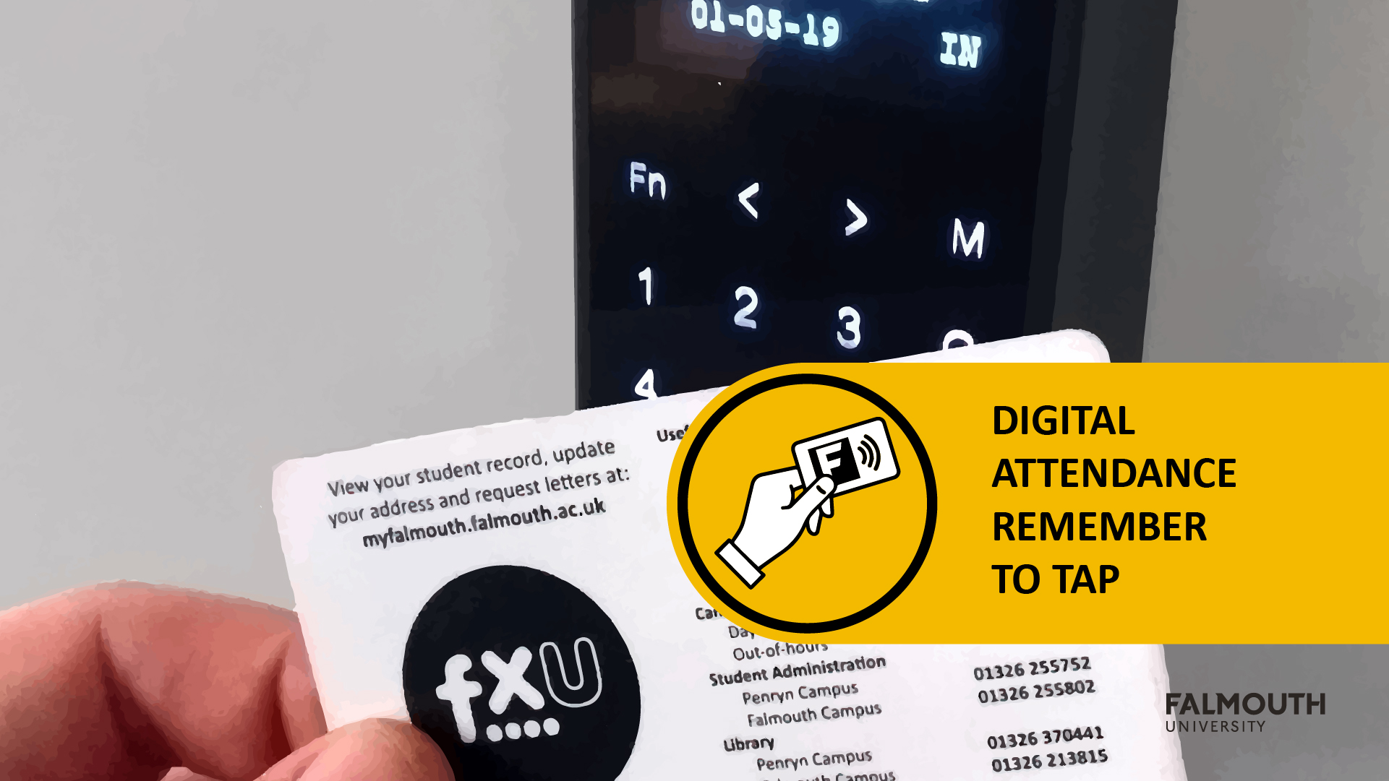

Slide 2


EXPO
Planning

Slide 3
Expo Reminder
Expo will take place from the 4th – 7th of May in the Sports Hall
Monday 4th - Setup Day
Tuesday 5th - Industry Day
Wednesday 6th - Games Academy Day
Thursday 7th – Community Day

Slide 4
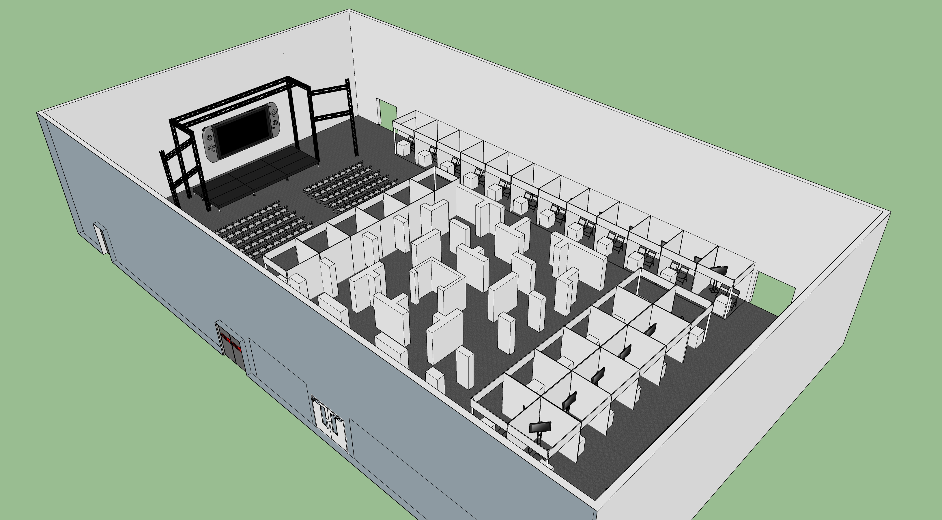
Show Floor

Slide 5
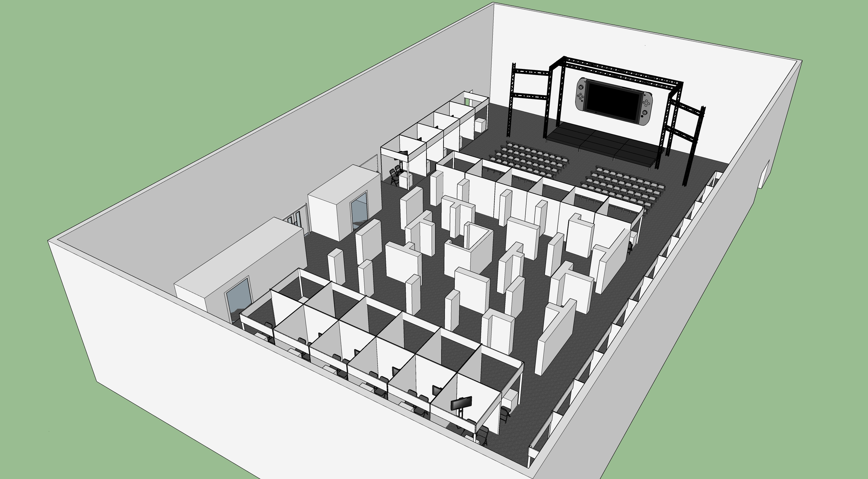
Show Floor

Slide 6
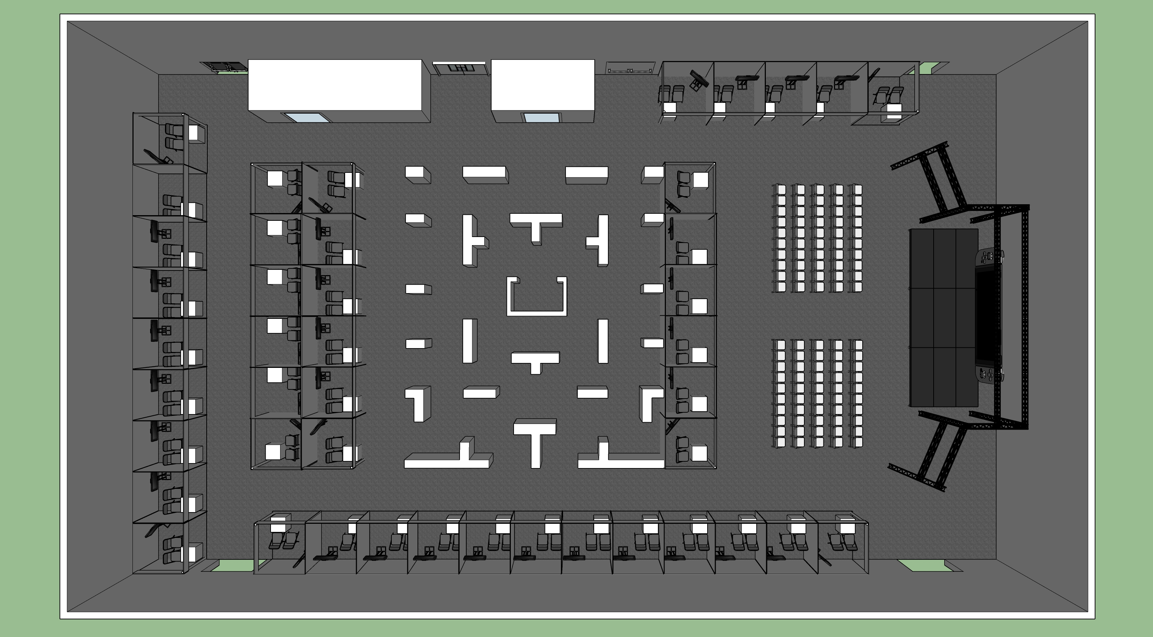
Show Floor

Slide 7
Expo Booth
The team will have the following:
2m x 2m booth
One table
One monitor and PC (similar spec to the GA machines)
If you have any special requirements, please start speaking to your Supervisors ASAP!

Slide 8
Expo Requirements
For the expo we are require you to have the following ready:
Game
Game Trailer
Booth Rota
Expo Materials
This is all part of the Studio Practice Assignment for GAM240
See Assignment Brief for details
https://learningspace.falmouth.ac.uk/mod/url/view.php?id=58230

Slide 9
The Game
The game should be in a playable state
Over and above this, the following are suggestions:
God mode
Attract mode
Cheat
A special expo build
Ability to restart the game with a keypress

Slide 10
The Game Trailer
This should show the gameplay of your game
The format is up to you
Flashy E3 style trailer
‘Lets’ play style
Traditional gameplay trailer
These will be collected in by the Techs and will be looked by the External Examiner to verify the marking process
So, this should really be a good showcase for your game!

Slide 11
Expo Rota
As a team you decide on a schedule for manning the booth
The rules are:
A minimum of two people need to be there each day
Everyone should take a turn
All team members should be present at some point on the Industry Day & Games Academy day
Everyone should be able to deliver the Elevator Pitch for the game
The Rota should be shown to your Supervisor in advance of the Expo
Please note, you will still need to sign-in for the Expo Day
Those not on the booths should be attending the Expo or taking a break

Slide 12
Expo Materials
These materials will directly impact on the look of your booth, so carefully consider the design of these materials
Banner for the Game – 2m x 2m
Team Logo and Ident – 2m x 30cm (wide)
Game Standee
These materials will need to be printed, so make sure you complete these in plenty of time
In addition, please proof read all materials!
Please note, it is the team's responsibility to design and make these. Please don’t put all the work onto the art team!

Slide 13
Expo Materials – Banner & Ident
These will be mounted on your booth
We are currently waiting on the final decision of what material we will use
e.g Vinyl vs Mesh
Please make sure your work is high resolution and high dpi (300 – 600 DPI for print is usual)
Start think about the design of these now, and consider working on a draft in the next Sprint
We will do a final communication to your email about this!

Slide 14
Expo Materials – Game Standees
These small stands will be used to explain your game and the controls
Think of it as a summary that someone would browse on a game box or on a steam/itch.io page
The standee should also feature the game controls, please consider making this easy to read and not just a block of text
This standee will also be used at Open Days and EGX
If you want to see good examples of these, please ask one of the Tech’s to see the Open Day Game Standees
We will provide a PSD template for this:
https://learningspace.falmouth.ac.uk/mod/resource/view.php?id=60914

Slide 15
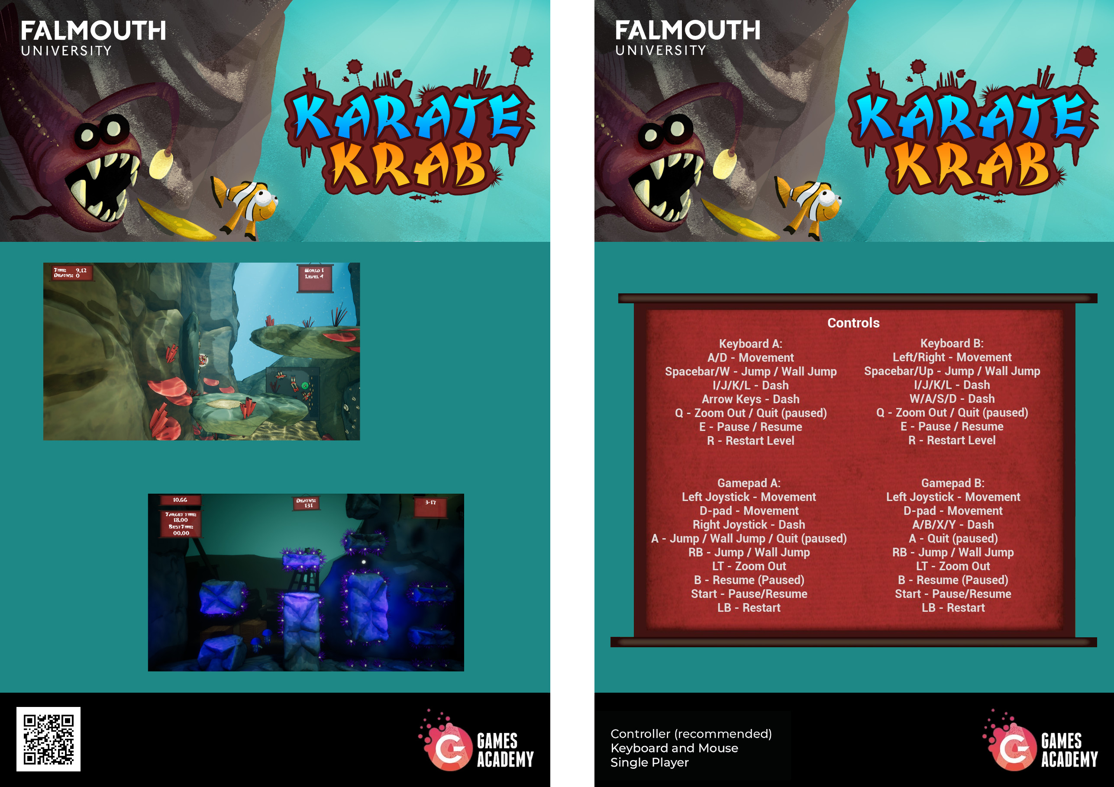
Expo Materials – Game Standees

Slide 16
Expo Materials – Game Standees

Slide 17
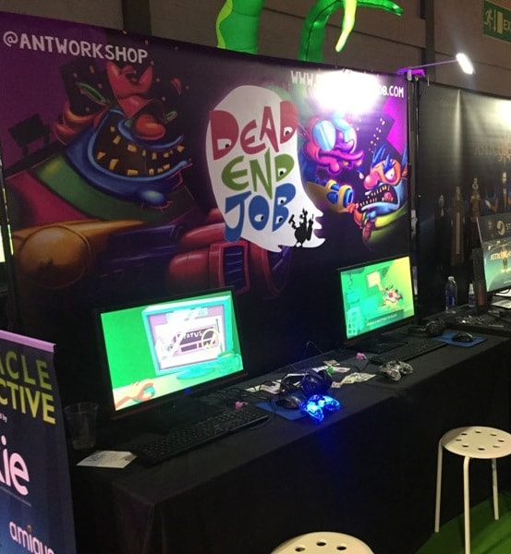
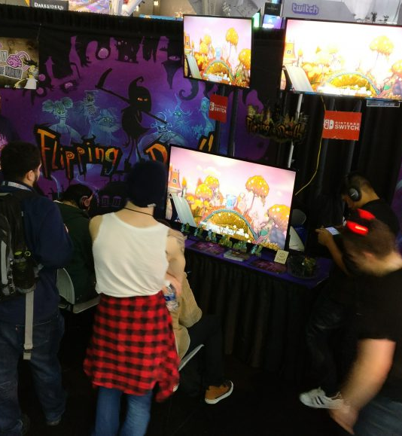

Slide 18
Useful Links
You suck at showcasing your game - https://www.youtube.com/watch?v=gB8CvsOjDvg
Planning a booth at PAX - http://www.zoinkgames.com/plan-convention-booth-pax-east/
How to showcase your Indie Game - https://www.gamasutra.com/blogs/LauraBularca/20160922/281849/How_to_show_your_indie_game_at_any_expo.php

Slide 19
Questions?

